Slide 1
Google Home
Pedro Almeida 89205
Dário Matos 89288
Samuel Duarte 89222
Teacher: Beatriz Sousa Santos
Course of Human-Computer Interaction
Class:P3
15/03/2020

Slide 2
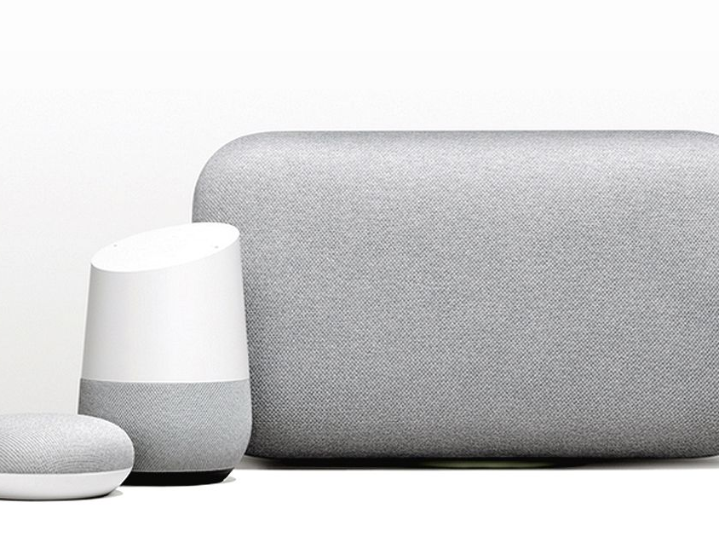
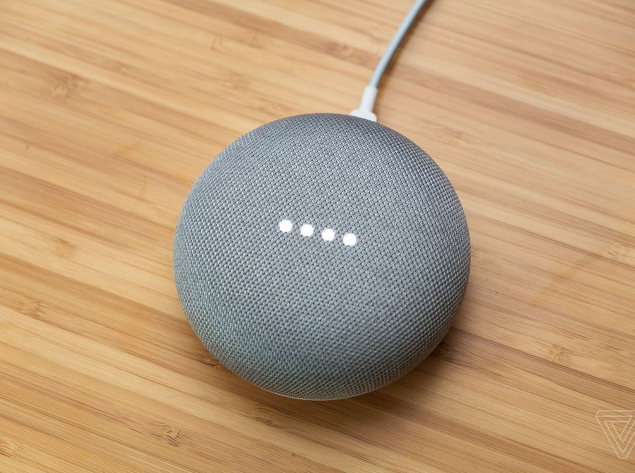
Why Google Home?
It was a suggestion from the teacher to see if the usability evaluation methods were appropriated to these types of devices.
We wanted to see if these methods were adaptable or if there is a need to create new ones.
We are going to evaluate the Mini Google Home version.

Slide 3
What is Google Home?
Smart speaker that enables users to speak voice commands to interact with services through Google Assistant or third-party services.
Allows for home automation features, enabling owners to use it as a central hub to control smart devices with their voice commands.

Slide 4
Evaluation
Severity Scale
To properly evaluate Google Home’s interface, the following set of Heuristics was used:
System Status
User Control And Freedom
Consistency and Standards
Error prevention
Recognition rather than recall
Flexibility and efficiency of use
0 = Disagreeing on the existence of a problem
1 = Cosmetic problem only, to be fixed if there is extra time
2 = Minor usability problem, low priority
3 = Major usability problem, high priority
4 = Usability catastrophe: imperative fix before releasing to production

Slide 5
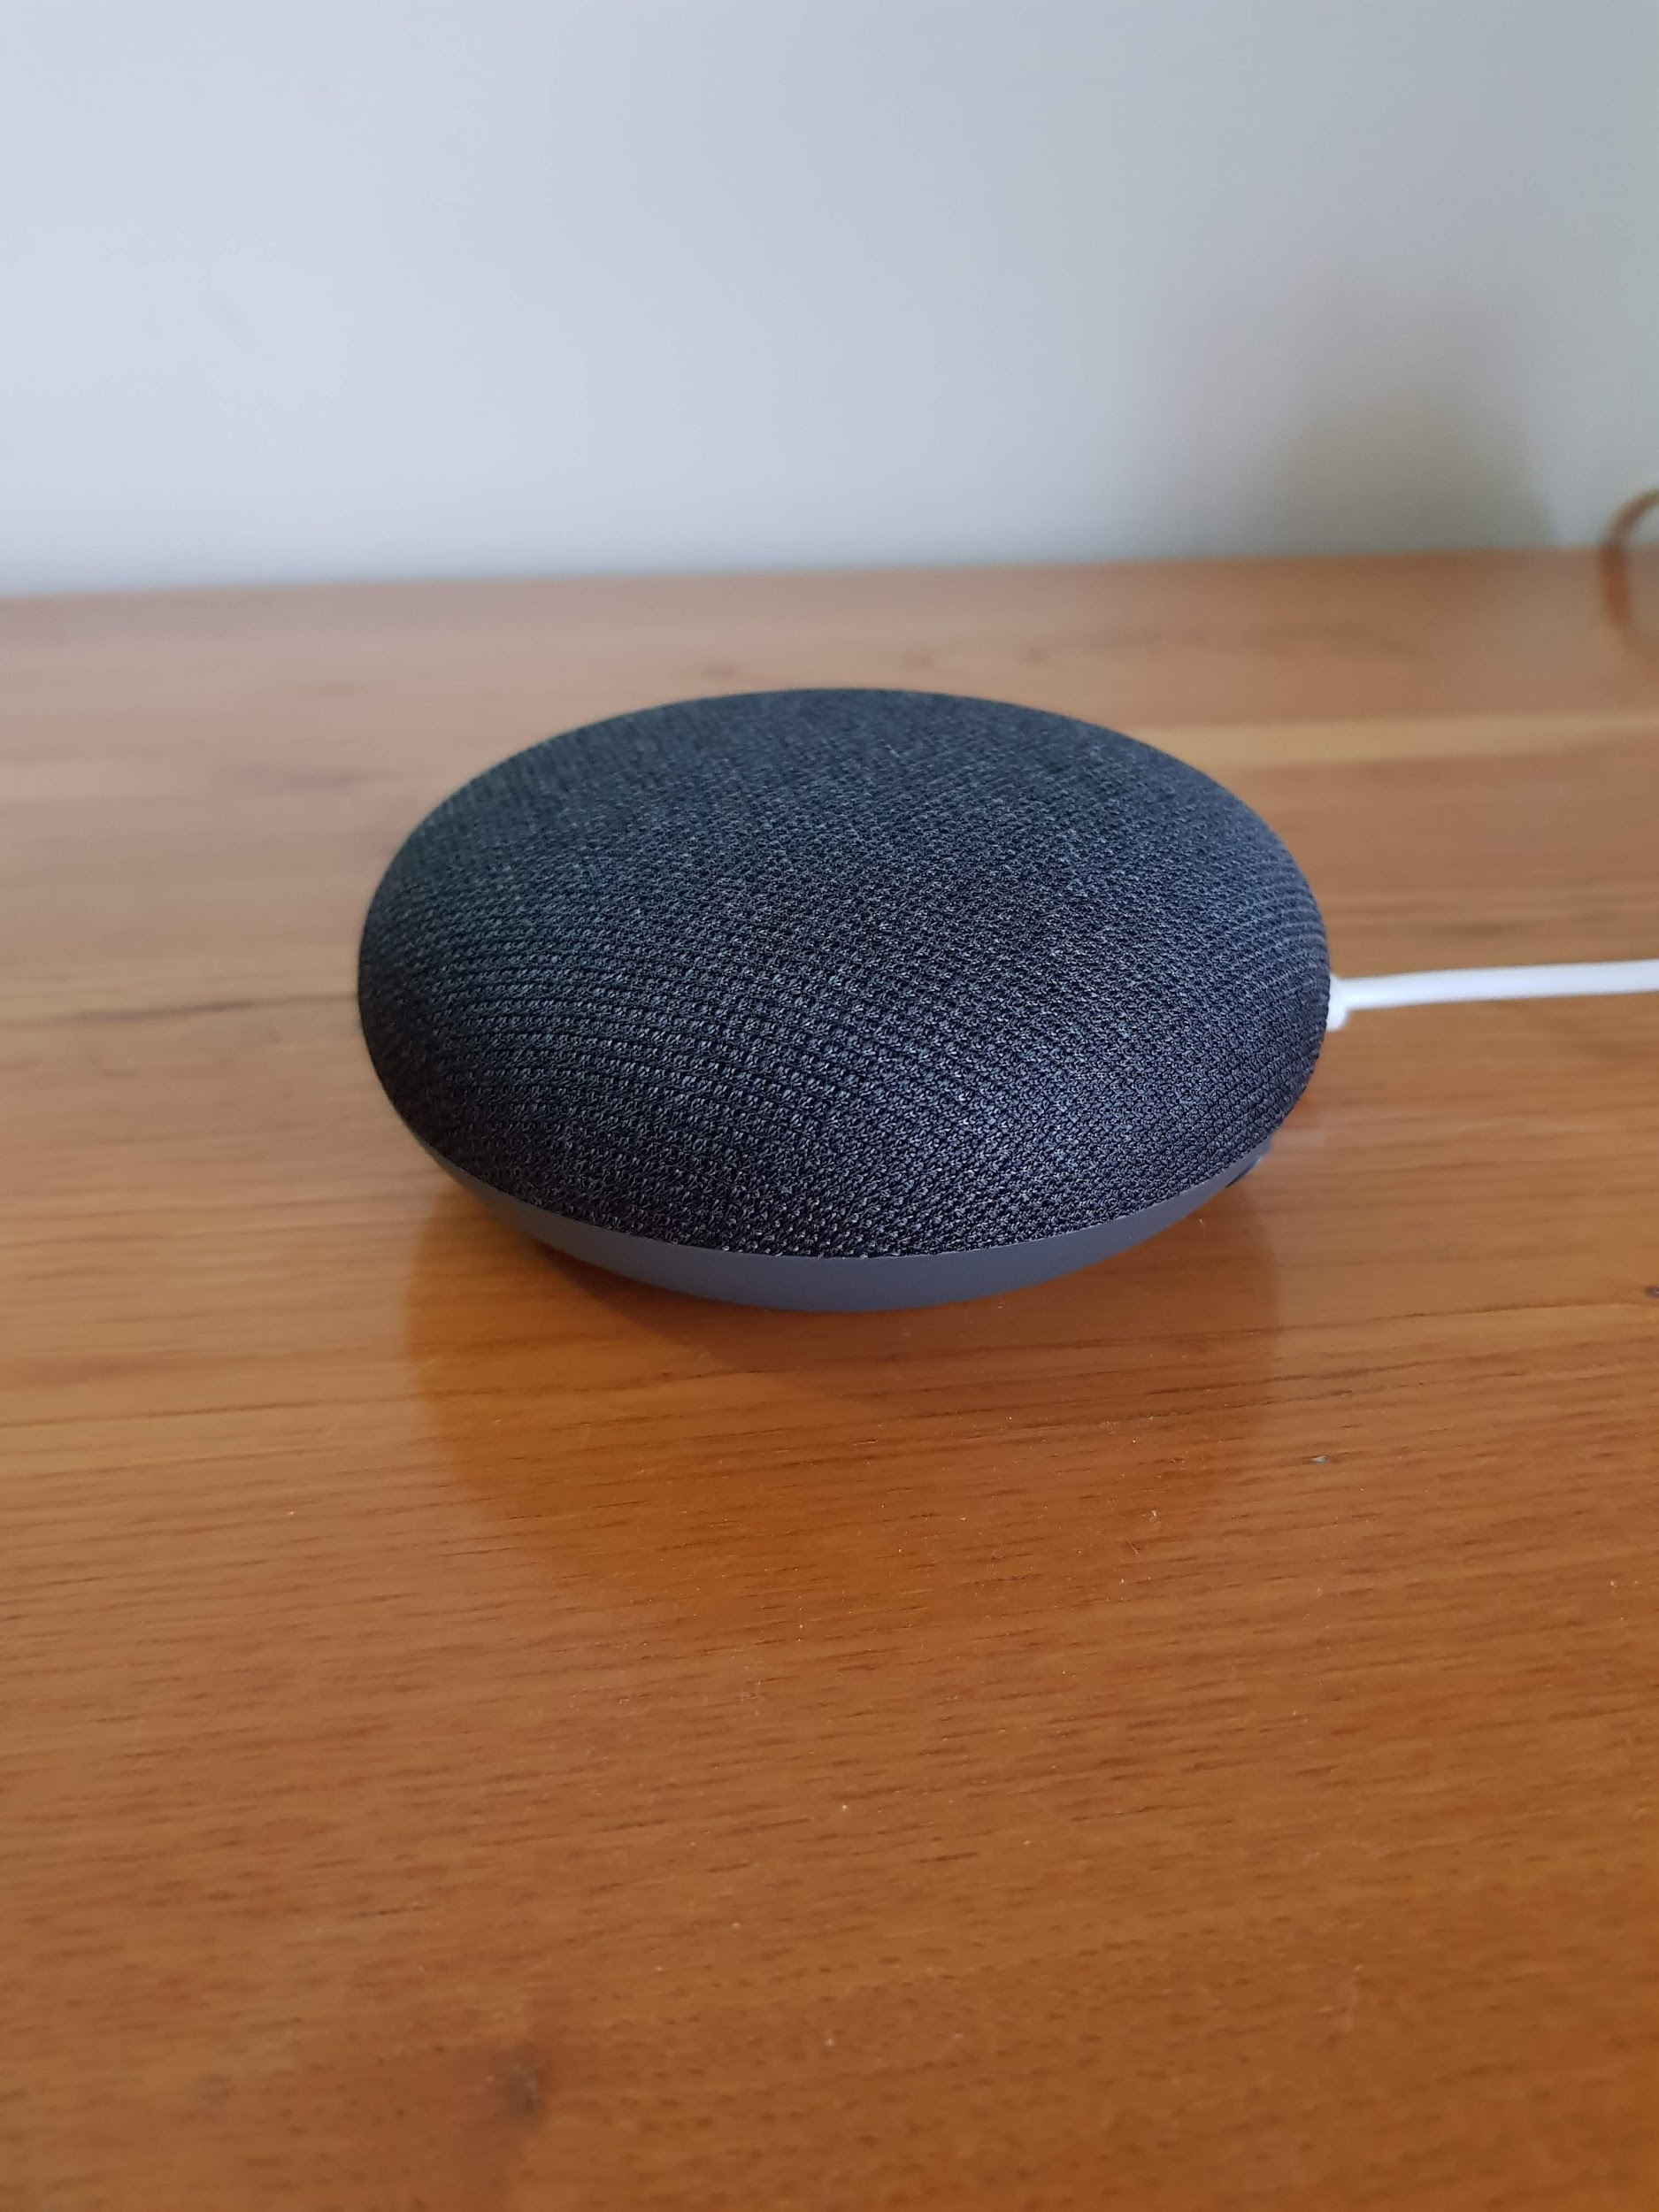
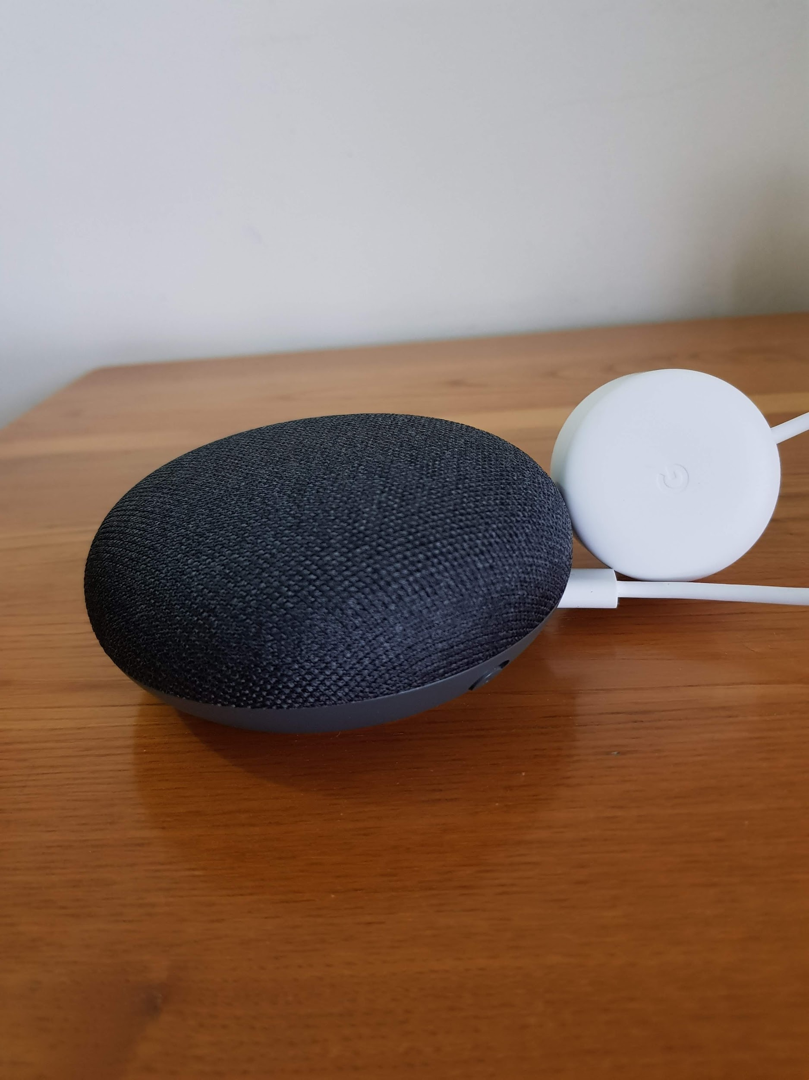
Heuristic Evaluation
Issue: There is no On/Off light
Heuristic: System status
Severity: 2,3
On
Off

Slide 6
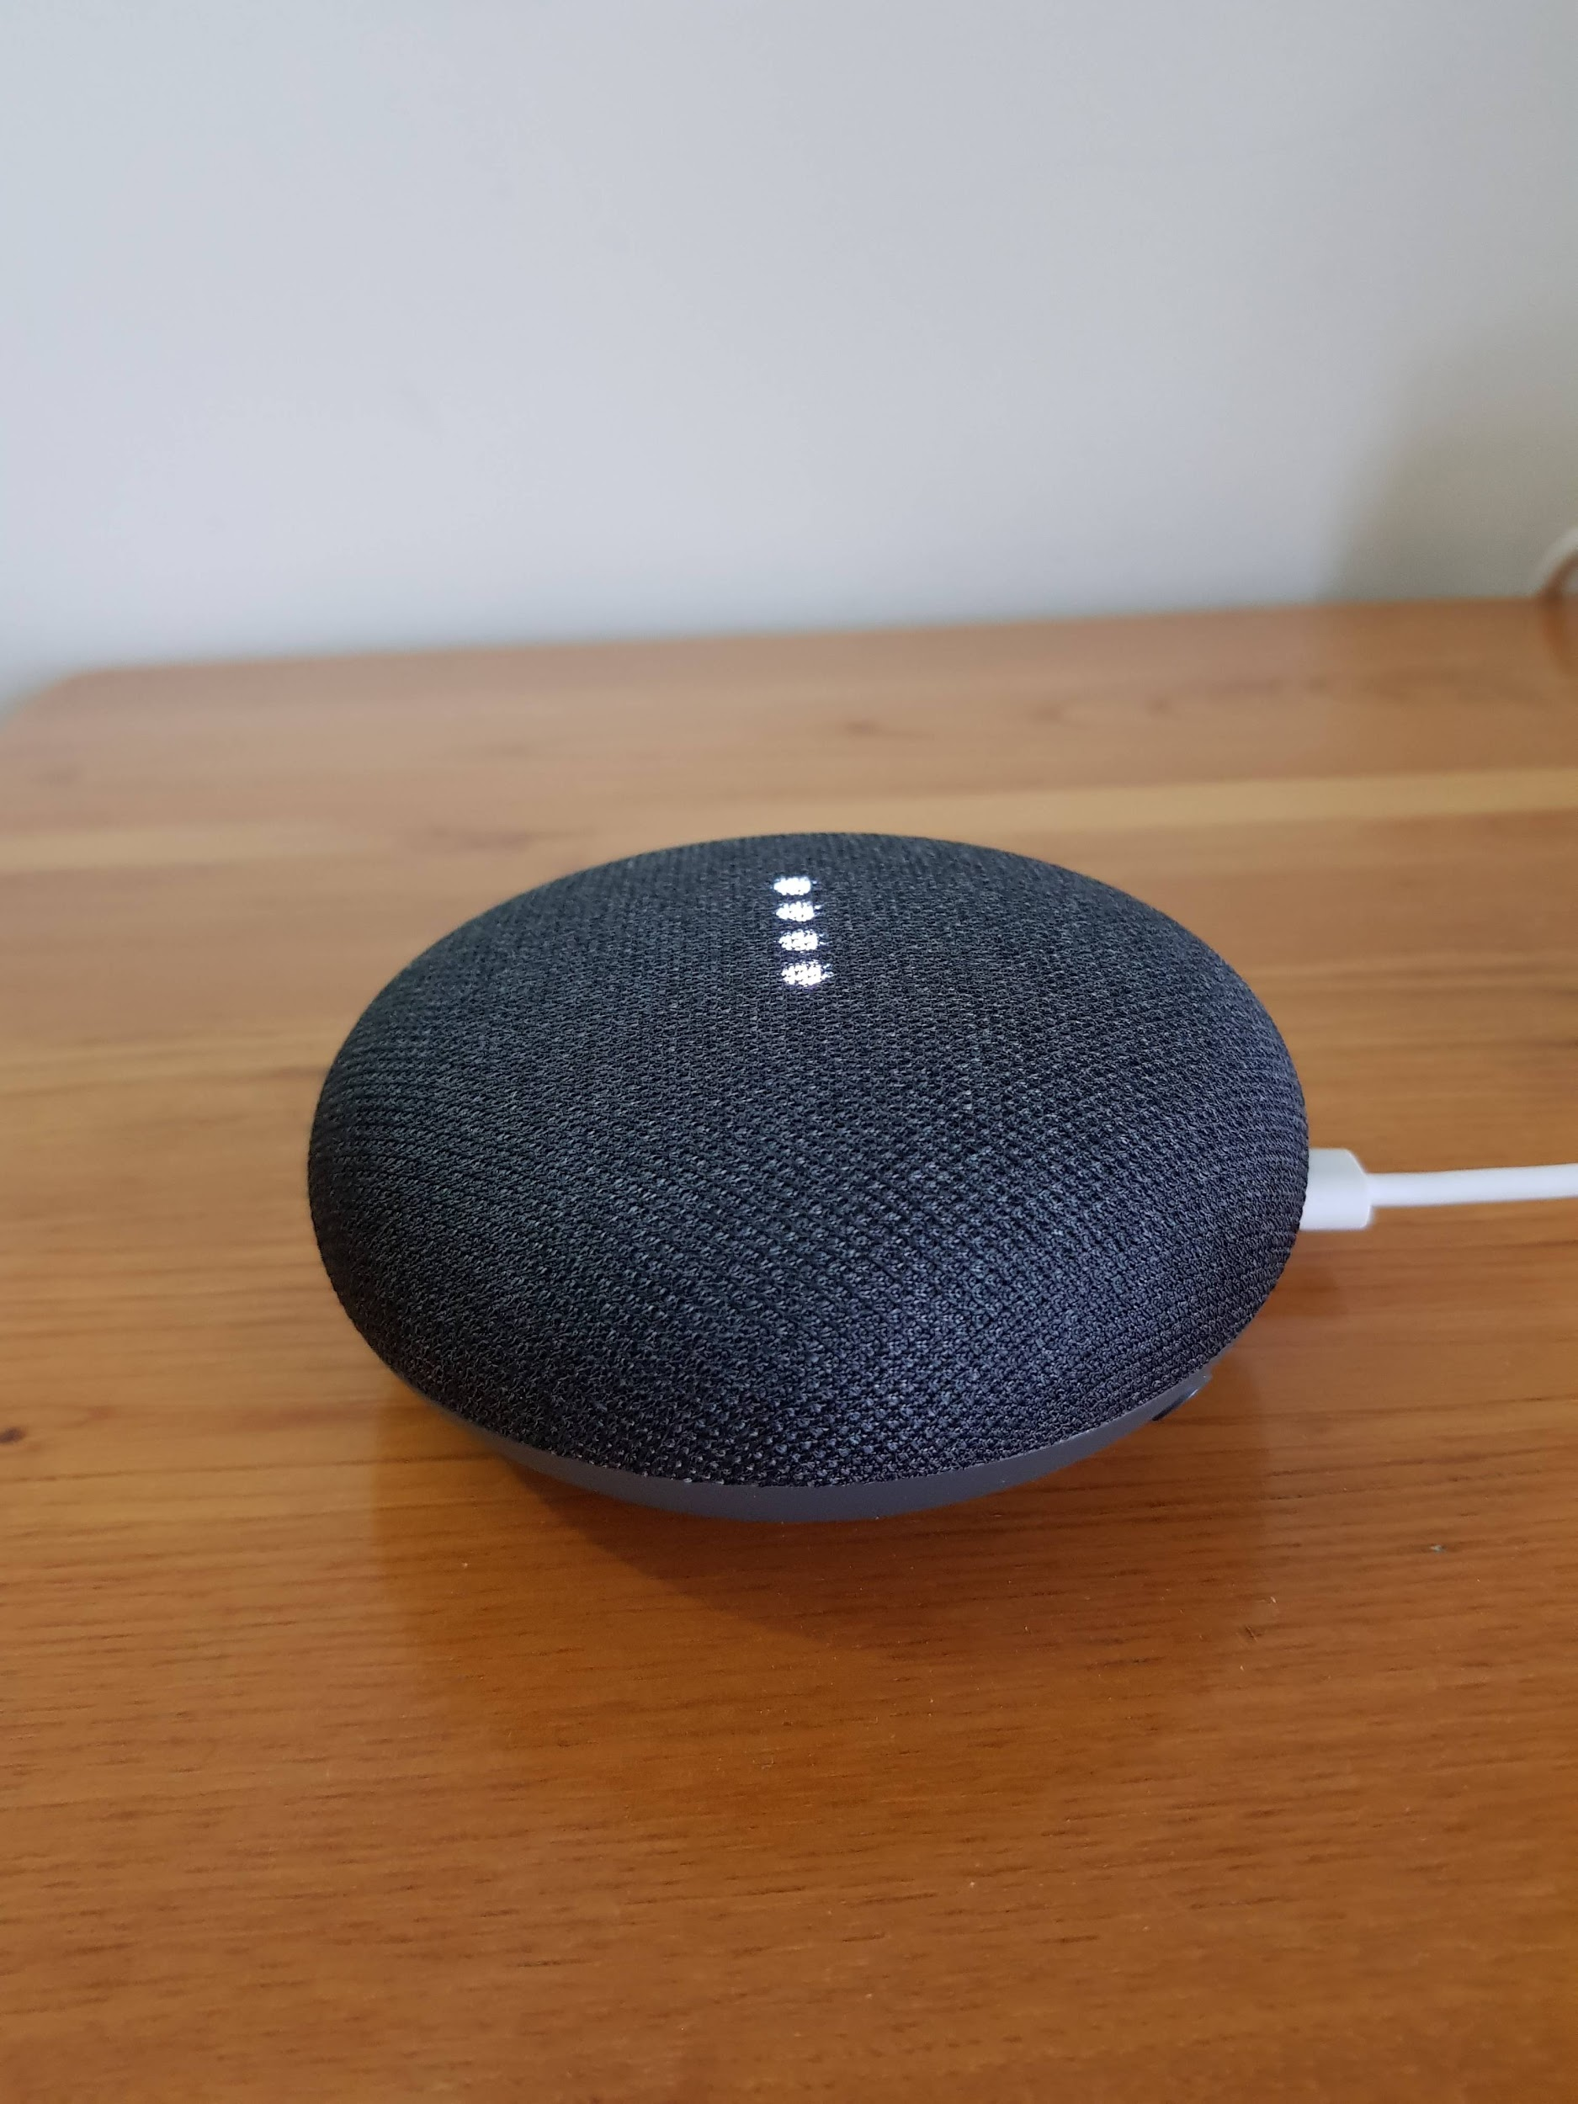

Heuristic Evaluation
Issue: Repeating a big phrase in cases of successful search
Heuristic: Flexibility and efficiency of use
Severity: 3
Q: “Where can I eat a nice hamburguer in downtown Lisbon?”

Slide 7
Heuristic Evaluation
Issue: The way you speak could lead to different outputs
Heuristic: Consistency and standards
Severity: 2,6
Q: “Play Dead Combo on Spotify”

Slide 8
Problems Found
Problem | Heuristic | Dário | Pedro | Samuel | Median
On/Off light | System status | 2 | 3 | 2 | 2,3
Repeat command if it misunderstand the first time | User control and freedom/Consistency and standards | 1 | 1 | 2 | 1,3
The way you speak could lead to different outputs | Consistency and standards | 2 | 3 | 3 | 2,6
Doesn´t understand what has been said | Error prevention | 1 | 2 | 2 | 1,6
No instructions visible, user must remember commands | Recognition rather than recall | 2 | 2 | 2 | 2
Repeating the whole phrase in cases of successful search | Flexibility and efficiency of use | 3 | 3 | 3 | 3
Summary of the problems found with Heuristic Evaluation by each evaluator.

Slide 9

Cognitive Walkthrough
Task: Setup a new device
User: Anyone with a Mini Google Home
Issue: No clear next step
Question: Will the user know what to do at this step?

Slide 10
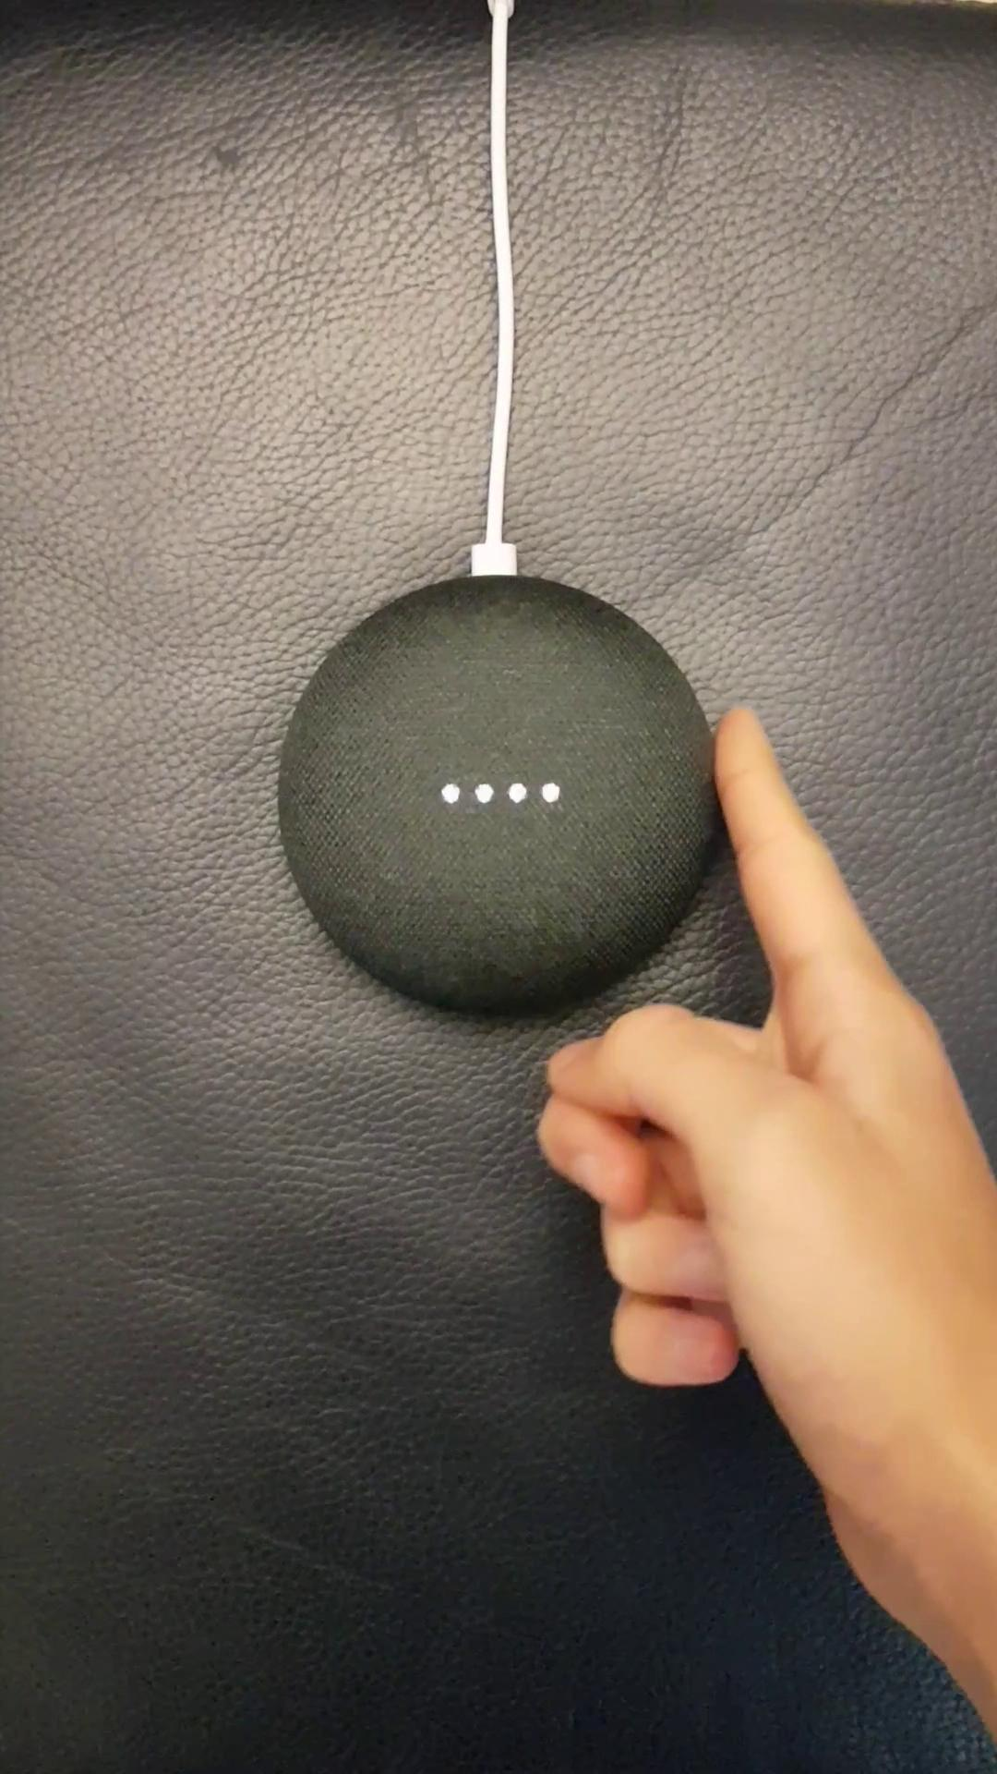
Cognitive Walkthrough
Task: Turn up/down the volume
User: Any user
Issue: Does not exist any indication on the device of the buttons to turn up or down the volume.
Question: Will the user know what to do at this step?

Slide 11
General appreciation
Simple to use
Minimalistic UI
Compatible with other applications and more than one device
Despite some flaws, the system works quite well. It allows for a variety of different languages to choose from and shows efficiency answering someone of intermediate proficiency in those languages.

